Slide 1
Intro Storyboarding

Slide 2
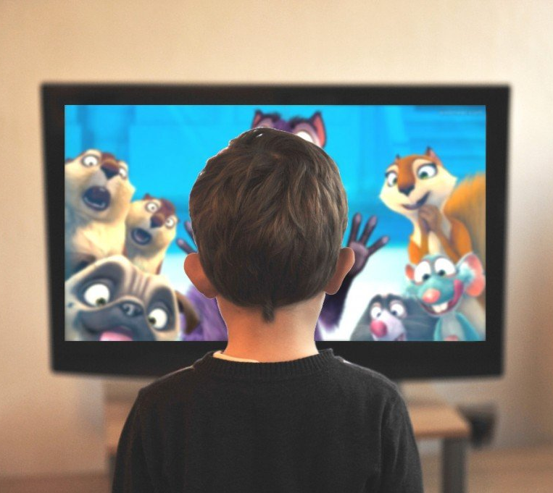

Visual Storytelling
We are constantly confronted with visual media:
Notes:
We are constantly confronted with visual media in our daily lives:
TV
Internet
Movies
Games

Slide 3
Visual Storytelling
We are constantly confronted with visual media:
Images are used to tell stories.
Stories are used to communicate a message.
Notes:
We are constantly confronted with visual media in our daily lives:
TV
Internet
Movies
Games

Slide 4

Visual Storytelling
Message can be:
To buy product.
Evoke an emotion from audience.
Notes:
That message can be to buy a product or to evoke an emotion from your
audience.

Slide 5
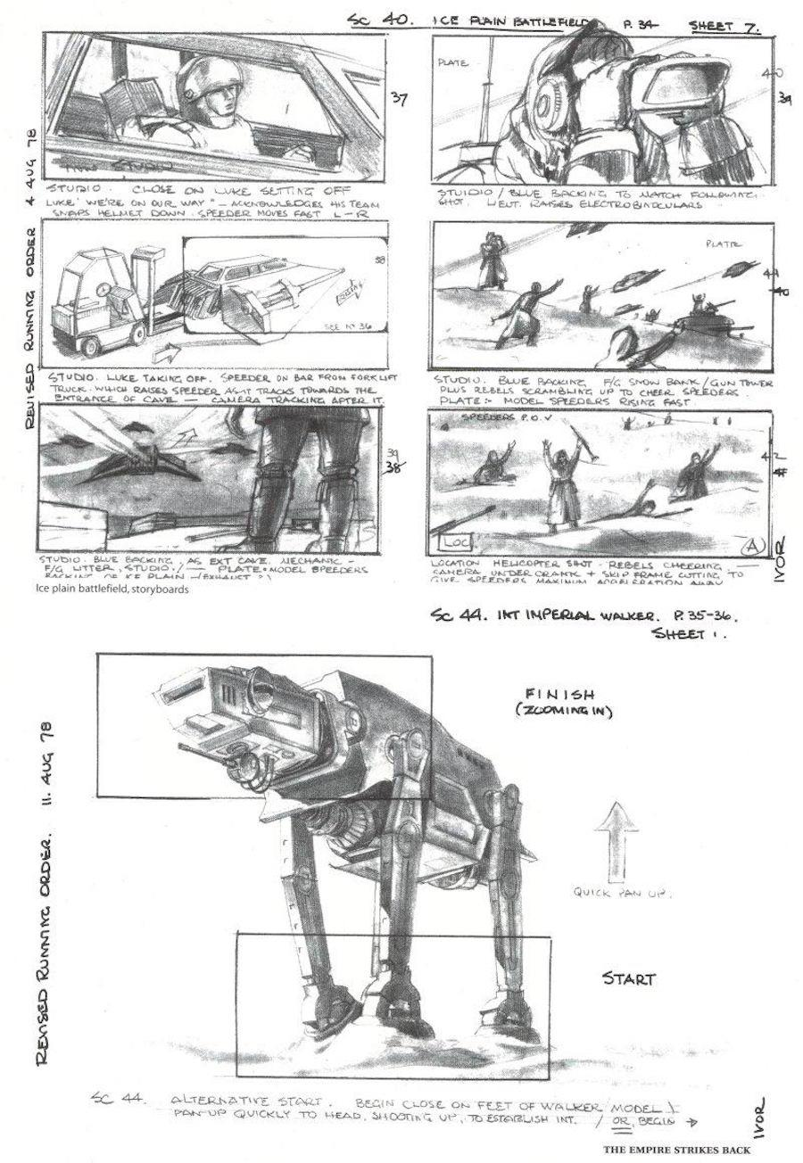
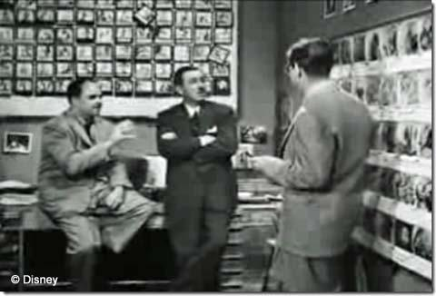
Storyboarding
The visual representation of the script.
Notes:
The storyboard can be thought of as a visual representation of the script or story.

Slide 6
Storyboarding
Graphic Organization in the form of illustrations or images
Displayed in sequence for the purpose of pre-visualizing a motion picture, animation or even an interactive piece.
Notes:
A storyboard is a method of organizing visual ideas graphically for motion pictures, animation, or even video games.

Slide 7
Storyboarding
Consists of a number of panels that show the visual action of a sequence in a logical narrative.
Notes:
Consists of a number of panels that show the visual action of a sequence in a logical narrative.

Slide 8
Storyboarding
Stories entertain
Storyboards are production tools to assist in selling an idea.
Notes:
Stories entertain, but storyboards are production tools to assist in selling an idea to a client, a production team, or to a director.

Slide 9
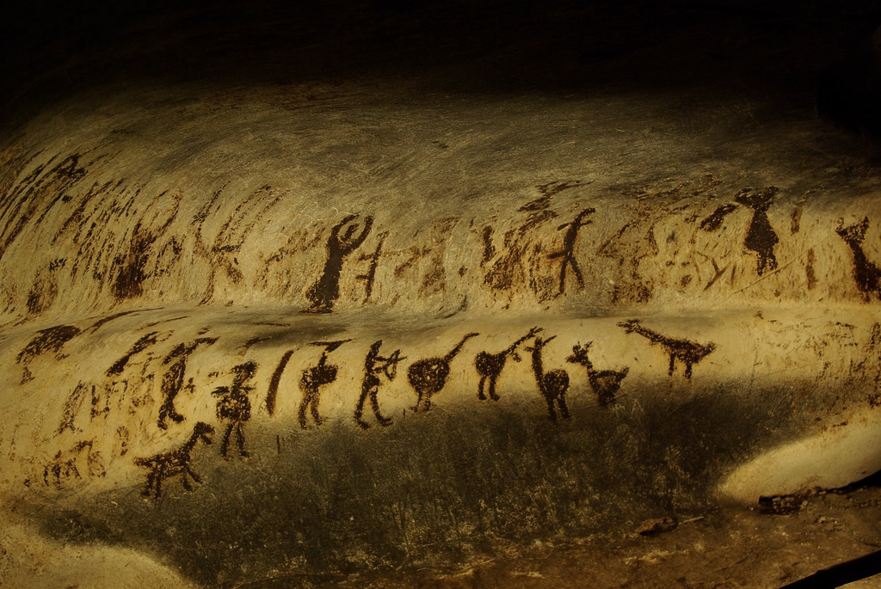
Visual Storytelling
Storyboarding refers to planning stories visually
Usually related to cinema, which is relatively new.
“Sequential Imaging” has been around for a long, long time.
Notes:
While storyboarding the visual flow of the narrative is a relatively New Concept, visual storyboarding is not. In fact, telling visual stories has been around for thousands of years. Early Rock paintings were used as a form of communication before speech was even developed. It has been believed that visual paintings told stories about Friends, animal attacks, how they hunted and so forth.

Slide 10
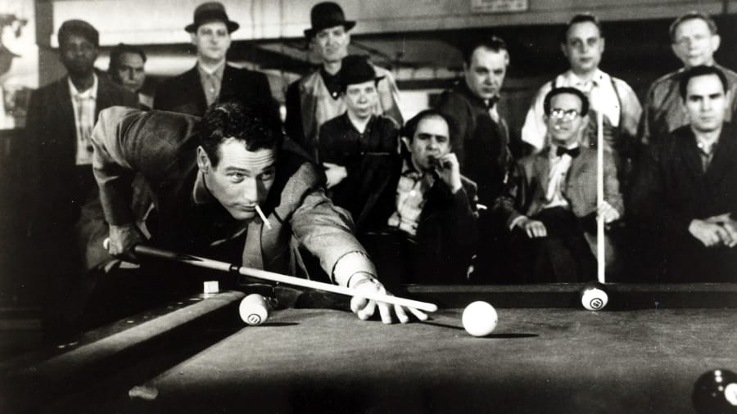
Visual Storytelling
Photography
Television
Motion Pictures
Computers
Comics
Notes:
Over the last century, visual storytelling has taken to new heights with the emergence of Photography television film and computers.
Graphic illustrations such as photographs comics, and magazines communicate their message without motion.

Slide 11
Visual Storytelling
What questions can be answered?
Who is this character?
Where is he playing pool?
Who is he playing against?
Notes:
The picture of a pool shark leaning against a pool table raises several questions. Who is the man? Where is he playing pool? Who is he playing against? Is he playing for money?

Slide 12
Visual Storytelling
The image conveys the intended message through staging the character and props, establishing the background, and portraying the action.
Notes:
The image conveys the intended message through staging the character and props, establishing the background, and portraying the action.

Slide 13
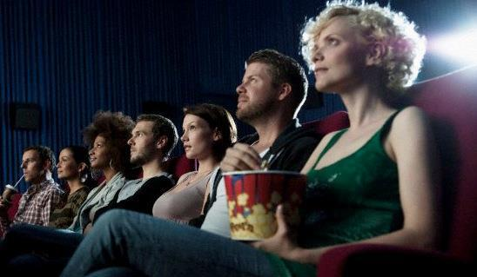
Linear vs. Nonlinear Storytelling
Movies
Animation
Comics
Notes:
Movies and animation are linear forms of visual storytelling where the audience listens and watches passively

Slide 14

Linear vs. Nonlinear Storytelling
Games
Interactive Applications
Some forms of theater or art
Notes:
Games and multimedia applications on the other hand are INTERACTIVE programs where the user both actively views and manipulates the program. A user of a game doesn't just sit back with a bucket of popcorn and watch the story unfold, but interact with the message whether it's plotting murder, looking for Clues, Dodge and a hailstorm of punches from an opponent.

Slide 15
Storytelling through Visuals
Although the needs and the methods of Storytelling may have changed over time, the storytellers purpose has pretty much stayed the same
Notes:
Although the needs and the methods of Storytelling may have changed over time, the storytellers purpose has pretty much stayed the same

Slide 16
Storytelling through Visuals
Storyboarding and storytelling is about communication
draws an audience into the story.
Visuals deliver story and message
Also a perspective of this story and message.
Notes:
to communicate a message to an audience. A storyteller's Effectiveness is based on drawing an audience into the story and capturing their attention. This is often accomplished by the message that the story and the visuals deliver.

Slide 17
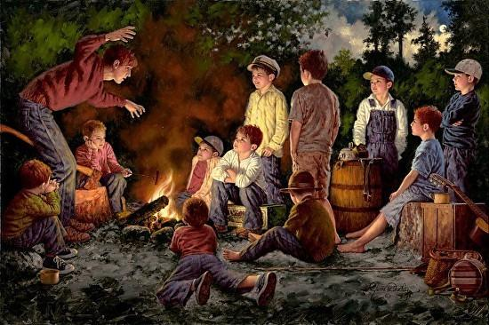
Show, don’t Tell.
If you tell a story, you try to entice the audience into imagining its content.
Notes:
Show, don't tell. This is a common phrase. It also happens to be the basis of writing visual content.
If you tell a story, you try to entice the audience into imagining its content.

Slide 18
Show, don’t Tell.
If you tell a story, you try to entice the audience into imagining its content.
If you're going to show the audience, you must rely less on telling and more on showing.
Notes:
However, if you're going to show the audience, you must rely Less on telling and more on showing.

Slide 19
Show, don’t Tell.
when you show a story, you are molding the message into visual imagery
Notes:
Think of it this way, when you show a story, you are molding the message into visual imagery. Let's look at an example of telling vs. showing.

Slide 20
Telling Example:
Jake, who was considered the bully of the neighborhood, stood on the corner of 10th and Main in his blue jeans, black T-shirt, and a cigarette pack rolled up in his sleeve.
The rest of the kids avoided the corner where Jake stood. They were intimidated by the high school dropout who derived pleasure from flicking the burning embers of his cigarette into the hair of any kid who crossed his path.

Slide 21
Showing Example:
Jake, a burly teen with pock marks on his cheeks and a skull tattoo scroll across his bicep, kicks a scuffed military boot in the dirt.
The dust circles his feet as he pulls a cigarette from behind his ear and slips it between his lips. His eyes dart to several schoolchildren that are standing in single file line waiting for their bus. He settles his gaze on a pint-size boy with a space rangers backpack slung over his small shoulders. Jake smirks as he takes a long drag from his cigarette and quickly steps forward toward the boy.
Notes:
Now that's more like it. The audience is able to see Jack kick the dirt up as he pulls a cigarette from behind his ear.

Slide 22
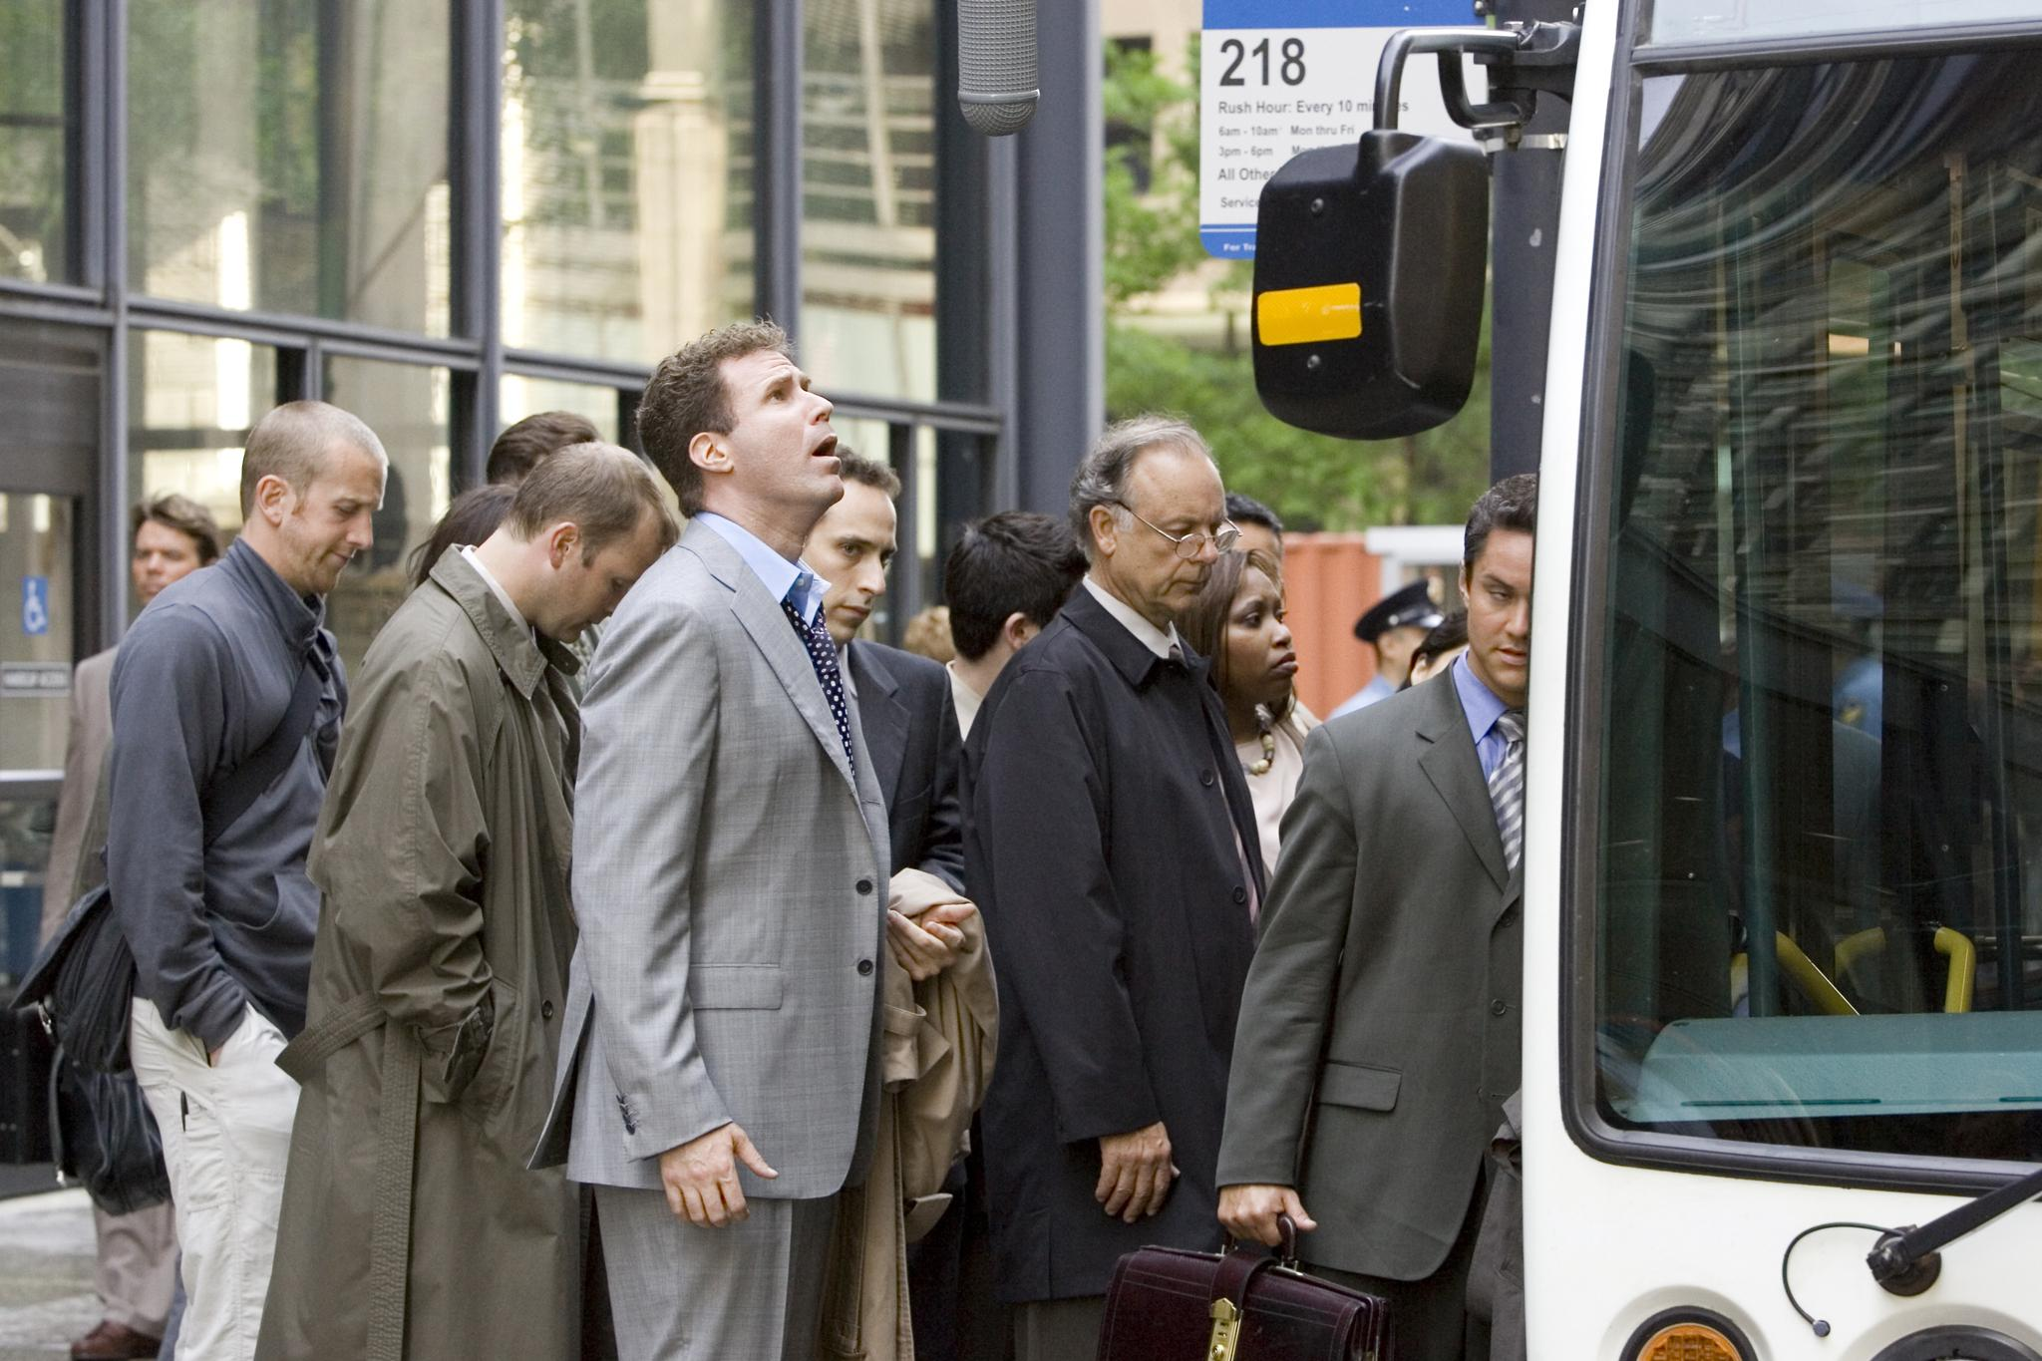
Showing Example:
When writing visual content, you want to show the actions of the characters, the Aesthetics of locations, and how the characters feel.
“Little did he Know” - A shot from “Stranger than Fiction” that plays with the idea of a character hearing events in his own life dictated by a narrator.

Slide 23
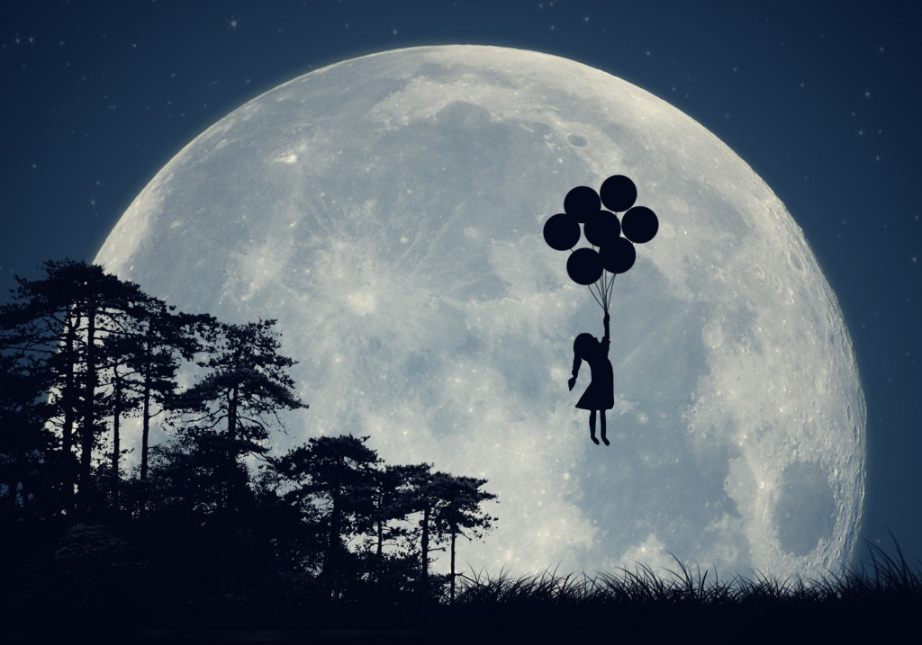
Elements of a Story
Most stories start out as an idea without structure (for example dreams)
Notes:
Most stories start out as an idea without structure.
For instance, think about your dreams.

Slide 24
Elements of a Story
Most stories start out as an idea without structure (for example dreams)
Fragments of Images strung together.
Notes:
Most stories start out as an idea without structure.
For instance, think about your dreams. Usually they are nothing more than fragments of images strong together. This is how ideas usually germinated.

Slide 25
Elements of a Story
Abstract images that take form over time
Structure and order added later.
Notes:
They often begin as abstract images that take form over time, as structure and order our later added to the mix.

Slide 26
Example
Bridge
Boat
Cyclist
Notes:
There are three images Bridge, boat and by cyclist.
Alone they are no more than words without meaning or interest to an audience.

Slide 27

Example
Bridge
Boat
Cyclist
Notes:
But what if you gave those words meaning through structure.
Stories need to be about something.
Therefore we could take or bicyclist and put him in a situation where he had to get across the bridge to deliver a package within the hour.

Slide 28
Example
Bridge
Boat
Cyclist
Notes:
We are now beginning to structure or story within an action or goal on the part of the bicyclist.
But wait. All good stories need conflict.
What if the bridge goes up to let a boat pass, making it difficult for the bicyclist, to reach his goal in time?

Slide 29


Example
Bridge
Boat
Cyclist
Notes:
Using a time element, or ticking clock, raises the stakes for or bicyclist, as in Figure 1-3.

Slide 30
Example
Bridge
Boat
Cyclist
Notes:
The author must have these questions answered by the end of the story if the audience is to walk away satisfied.
Once the problem is solved and the package is delivered in time (or not) the story is resolved.

Slide 31
Dramatic Structure:
as the beginning, middle, and end,
act 1, act 2, and act 3
Notes:
Dramatic structure is usually defined as the beginning, middle, and end, or if it is a screenplay, act 1, act 2, and act 3. No matter what you call it, the purpose is the same, which is to structure the flow of a story to give it meaning.

Slide 32
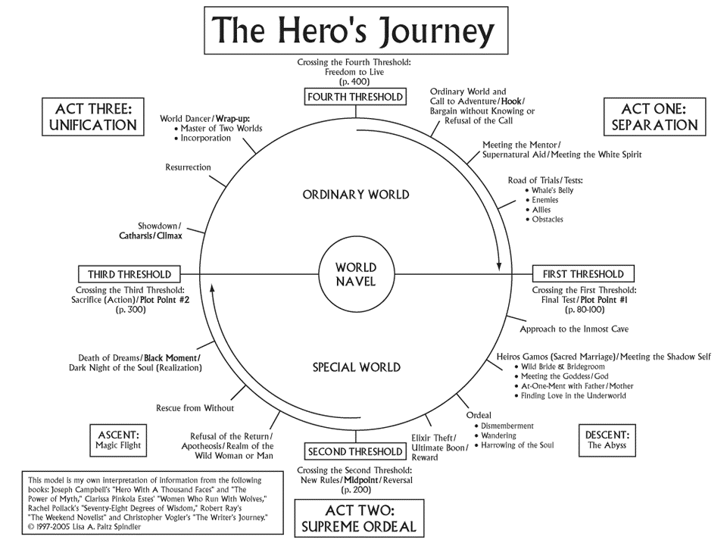
Notes:
Joseph Campbell, an American mythological researcher, wrote a famous book entitled The Hero with a Thousand Faces. In his lifelong research Campbell discovered many common patterns running through hero myths and stories from around the world.

Slide 33
Notes:
Years of research lead Campbell to discover several basic stages that almost every hero-quest goes through (no matter what culture the myth is a part of). He calls this common structure “the monomyth.”

Slide 34
Notes:
Understanding how stories are put together, which includes the hero's journey, is an integral part 2 creating storyboards. Let's take a brief look at each phase of the visual storytelling process from beginning, to middle, to end.

Slide 35
But why stories about Heroes?

Slide 36
But why stories about Heroes?
Because these are the stories worth telling.
Notes:
Heroes to not have to be necessarily endowed with special powers or abilities. Heroes are those people who are considered to have risen above their ordinary surroundings, or overcome an obstacle that others have not. This is what makes them special, and their stories worthy of attention.

Slide 37
The Beginning
Notes:
THE BEGINNING:
The beginning, or act one, in film, television, and animation, is where the Storyteller sets up the characters, location, and conflict of the story.

Slide 38
The Beginning
Who are the characters?
Where are they?
When does the story take place (the future, past, or present)?
Why are the characters there?
Notes:
Several questions that need to be answered include:
Who are the characters?
Where are they?
When does the story take place (the future, past, or present)?
Why are the characters there?

Slide 39
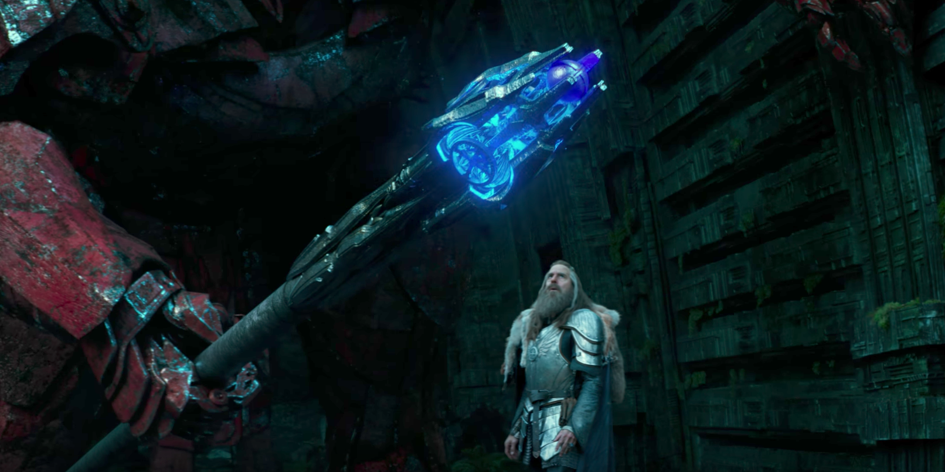
The Beginning
(Transformers: The Last Knight)
Notes:
Dynamic stories may begin with a hook that grabs the audience's attention,
Such as a murder or kidnapping.
Action sequences make great hooks, although they are not the only types of scenes that keep the audience watching.

Slide 40
The Beginning
(Transformers: The Last Knight)
Notes:
For example, the hook in a story maybe a couple breaking up or it may be as simple as a character receiving an eviction notice.
In the example here on this slide, from one of the transformers movies, shows a scene simply to contextualize the main story in the movie.
We never see these characters again, but the scene serves to set the stage for what is to come.

Slide 41
The Beginning
(Transformers: The Last Knight)
Notes:
The hook should leave the audience asking questions. For instance why did the woman get evicted from her apartment? Who kidnapped the girl? What caused the couple to split apart, if the audience is hooked they won't undoubtably want to know what happens next and keep watching.

Slide 42
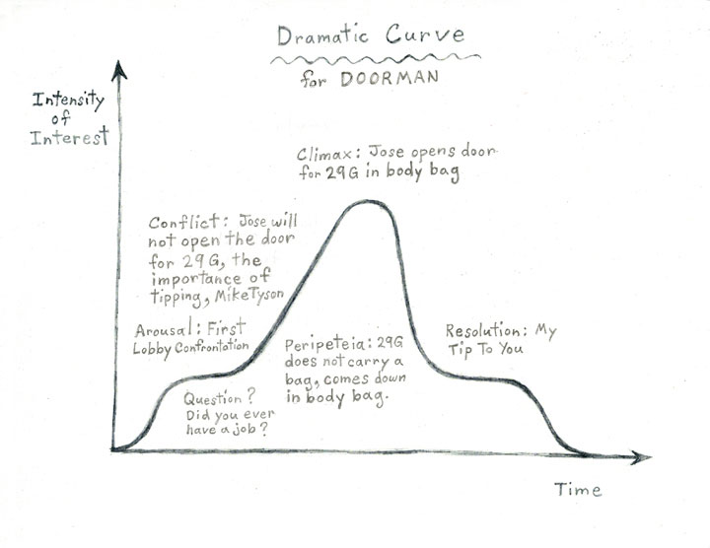
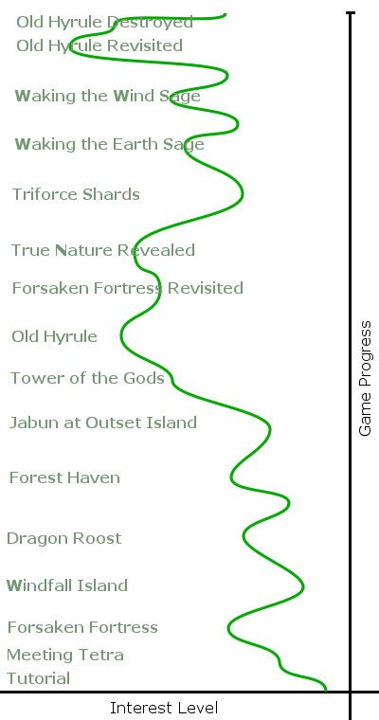
The Beginning
Interest Curve:
“The quality of an entertainment experience can be measured by the extent to which its unfolding sequence of events is able to hold a guest’s interest”
- Jesse Schell ( Art of Game Design)
Notes:
The concept of an “Interest curve” that I’ve borrowed here from Game Design is also very useful when it comes to storytelling.

Slide 43
The Beginning
(Transformers: The Last Knight)
Notes:
The beginning also defines the heroes goal.
It is to save the kidnapped Princess, get a job, save the world, or defeat the towns evil mayor?

Slide 44
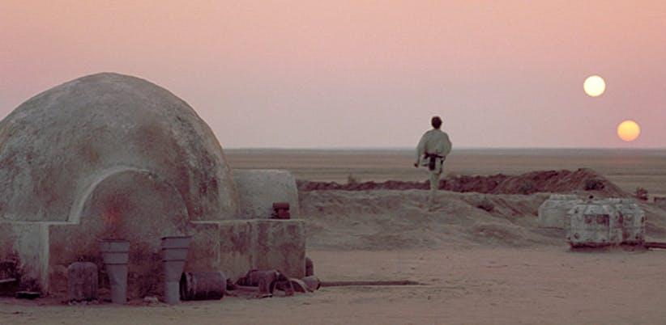
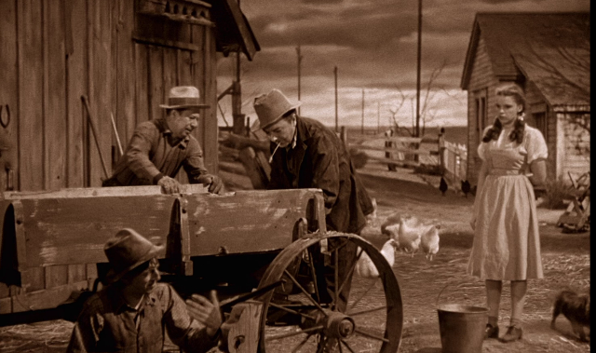
The Beginning:
Notes:
It also serves to introduce the character and his/her world to the audience.
Heroes exist in a world is considered ordinary or uneventful by those who live there. Often the heroes are considered odd by those in the ordinary world and possess some ability or characteristic that makes them feel out-of-place.

Slide 45
The Beginning:
The Wonderful Wizard of Oz: Dorothy in Kansas
The Hobbit: Bilbo Baggins in the Shire
Star Wars: Luke Skywalker on Tatooine
The Lion King: Simba at Pride Rock
Notes:
Here are some examples of this first stage:

Slide 46
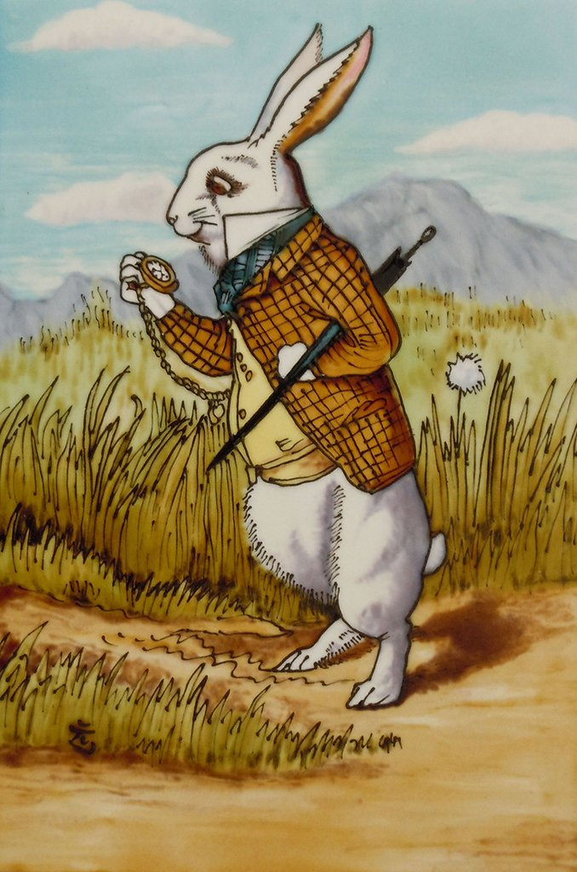
The Beginning:
Discovery of Danger that leads to heroic path
Character is confronted by a choice. – either following the heroic path to adventure, or living their otherwise normal/conventional life.
Announcement of a “Quest” or event that could potentially change a situation.
Notes:
For heroes to begin their journeys, they must be called away from the ordinary world. Fantastic quests don’t happen in everyday life. Heroes must be removed from their typical environment. Most heroes show a reluctance to leave their home, their friends, and their life to journey on a quest. But in the end they accept their destiny.

Slide 47

The Beginning
THE CALL TO ADVENTURE:
New world discovered is much different than old one.
“Fateful Region of both Treasure and Danger”
Notes:
The new world the hero is forced into is much different than the old one. Campbell describes this new world as a “fateful region of both treasure and danger…a distant land, a forest, a kingdom underground, beneath the waves, or above the sky, a secret island, lofty mountaintop, or profound dream state…a place of strangely fluid and polymorphous beings, unimaginable torments, superhuman deeds, and impossible delight”.

Slide 48
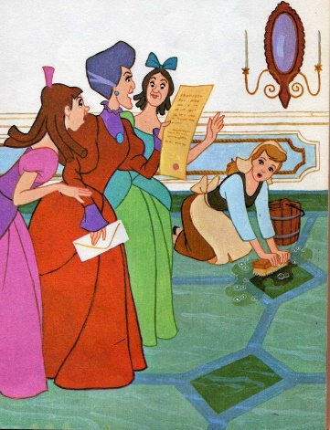
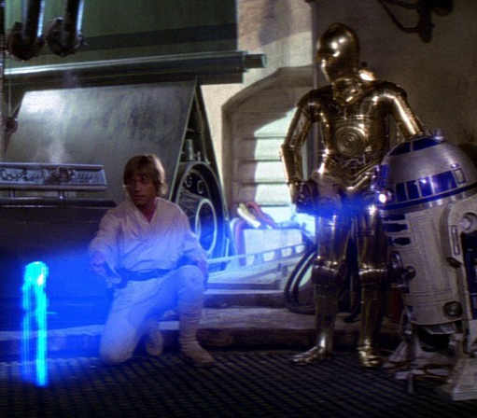
The Beginning
The Wonderful Wizard of Oz: The tornado
The Hobbit: Gandalf the wizard arrives
Star Wars: R2D2’s cryptic message
Notes:
This description may seem pretty vague, but think of all the various fantasy realms characters have entered throughout the years: Middle-Earth, Oz, Narnia, Wonderland. It could even be outer space, a haunted house, or the Matrix. Regardless of the details, the new world is sure to be filled with adventure.
Here are some examples of this stage.

Slide 49
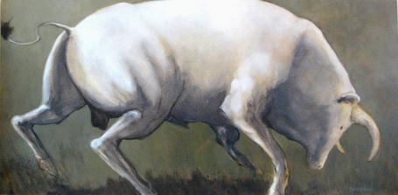

The Beginning:
REFUSAL OF THE QUETS:
Without hero accepting quest, there is no story.
There are consequences for not accepting quest.
Notes:
During the Call to Adventure heroes are given a task or quest which only they can complete. They are faced with a choice: accept the quest or deny it. Their choice might seem like a no-brainer. If they don’t accept the quest, there won’t be much of a story—or will there?

Slide 50
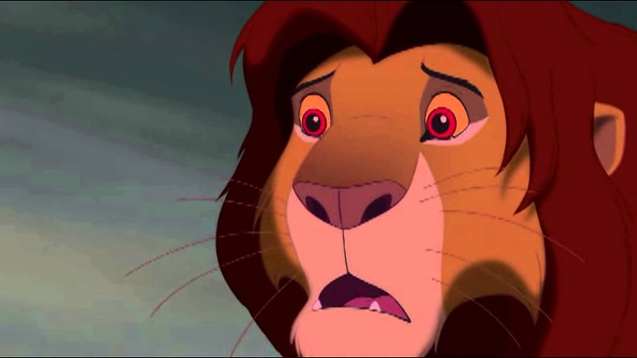
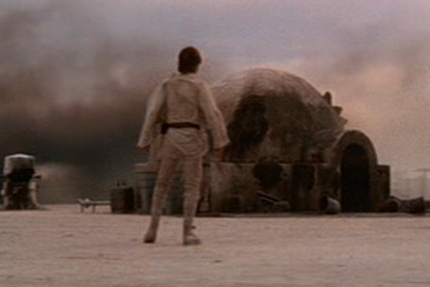
The Beginning
Star Wars: Luke refuses the quest until he learns his aunt and uncle are dead
The Lion King: Simba refuses to return to Pride Rock and accept his destiny
Groundhog Day: Example of the negative cycle caused by refusing the call
Notes:
Here are some examples of heroes refusing the quest:

Slide 51
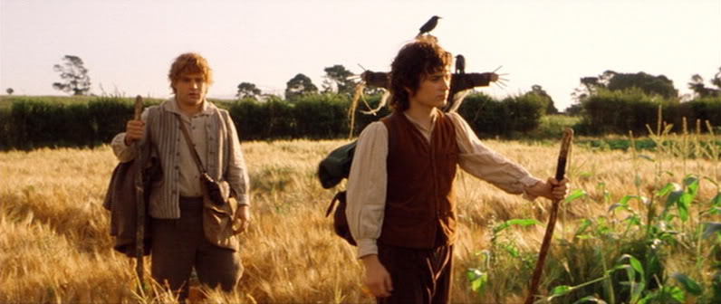
The Beginning
By accepting the call, the heroes advance into the next stage of their journey.

Slide 52
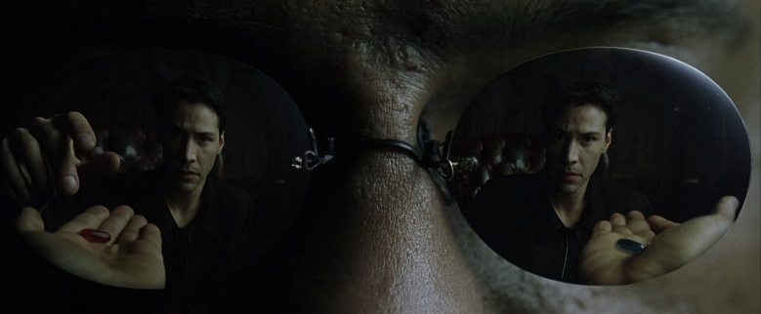
The Beginning
By accepting the call, the heroes advance into the next stage of their journey.

Slide 53
The Middle
Hero faces many complications and obstacles
The middle contains many twists and turns
Keeps raising the stakes to keep the story interesting and the tension building.
Often times something will happen to fundamentally change a character.

Slide 54
The Middle: Entering the Unknown
Goodbye to “Comfort Zone”
Stage in which hero grows through tests.
It is not the end of the journey which teaches, but the journey itself.
Notes:
As they embark on their journey, the heroes enter a world they have never experienced before. Very often it is filled with supernatural creatures, breathtaking sights, and the constant threat of death. Unlike the heroes’ home, this outside world has its own rules, and they quickly learns to respect these rules as their endurance, strength, and mettle are tested time and time again. After all, it is not the end of the journey which teaches, but the journey itself.

Slide 55
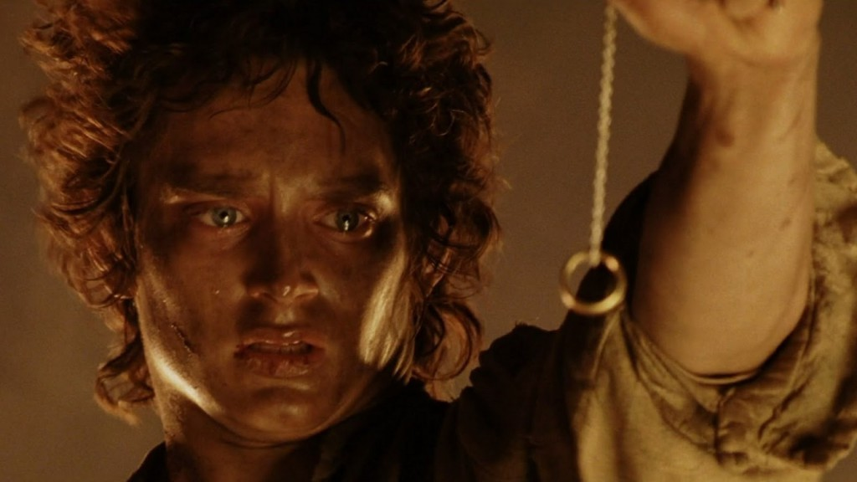
The Middle: Tests and the Supreme Ordeal
Star Wars: Blowing up the Death Star
Lord of the Rings: Mount Doom
The Wizard of Oz: Defeating the Wicked Witch
Notes:
The heroes progress through a series of tests, a set of obstacles that make them stronger, preparing them for their final showdown. At long last they reach the Supreme Ordeal, the obstacle they have journeyed so far to overcome. All the heroes’ training and toil comes into play now. The journey has hardened them, and it’s time for them to show their prowess. Once this obstacle is overcome, the tension will be relieved. The worst is passed, and the quest, while not officially over, has succeeded.

Slide 56
The End
Where the climax and resolution of the problem occur
The hero's goal is attained, the problem is solved, etc.
Many include a showdown, or final confrontation (often between the protagonist and antagonist).
The action becomes most intense near the end as the hero makes a last stand

Slide 57
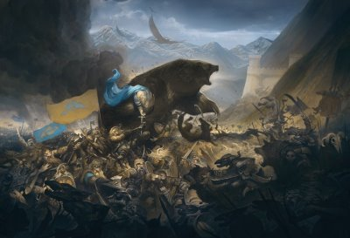
The End: Reward and the Journey Home
The Hobbit: The Battle of Five Armies (even after defeating Smaug)
The Lord of the Rings: Return to the Shire
Notes:
Typically, there is a reward given to heroes for passing the Supreme Ordeal. It could be a kingdom. It could be the hand of a beautiful princess. It could be the Holy Grail. Whatever it is, it is a reward for the heroes’ endurance and strength.
After the heroes complete the Supreme Ordeal and have the reward firmly in hand, all that is left is for them to return home. Just because the majority of the adventure has passed doesn’t mean that the return journey will be smooth sailing. There are still lesser homebound obstacles to overcome.

Slide 58
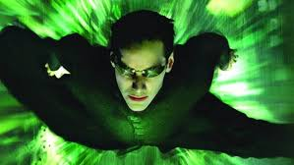
The End: Reward and the Journey Home
Lord of the Rings: Frodo saves the Shire
The Wizard of Oz: Dorothy rids Oz of the Wicked Witch
Notes:
Success on the heroes’ quest is life-changing, for them and often for many others. By achieving victory, they have changed or preserved their original world. Often they return with “the exilir,” an object or personal ability that allows them to save their world. The heroes have also grown in spirit and strength. They have proved themselves worthy for marriage, kingship, or queenship. Their mastery of the outside world qualifies them to be giants in their own.

Slide 59
Why Format the Story?
The script is the blueprint for a production.
Provides the writer with a means of communication that is intended for the Project Director and crew members.
It is the screenwriters job to tell the story
The Director’s job is to shots.

Slide 60
Why Format the Story?
Helps with the rhythm
The format helps the producer or director visualize
The writers Concepts and ideas.
The script is also formatted to make things easier (schedules, prop lists, etc)
Notes:
Formatting a screenplay helps with the rhythm of a story through the choice of camera positions, narration, dialogue, and the juxtaposition of lenses. The format guides the producer or director with visualizing the writers Concepts and ideas. The script is also formatted because it is much easier for the director of the production you have it broken down into numbered scenes, schedules, and prop lists.
In most situations, the script will be formatted in either a standard screenplay format or as a two-column script.

Slide 61
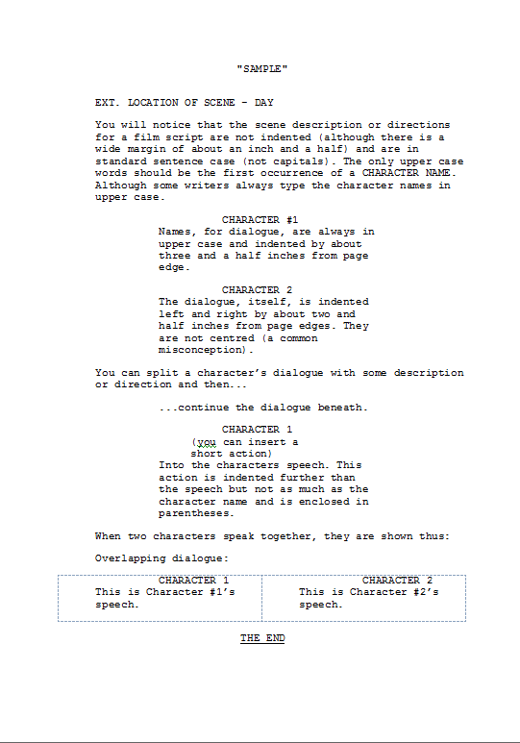
Standard Screenplay format
Used as a Production Tool for the director and crew members
Hollywood standard, which includes several elements as the slug line, and dialogue.
Notes:
Screenplays are not intended for audiences to read as they would a novel. Rather, they are used as a Production Tool for the director and crew members in the development of a film, Game, or animation. The screenplay has become the Hollywood standard, which includes several elements as the slug line, see description, and dialogue.

Slide 62
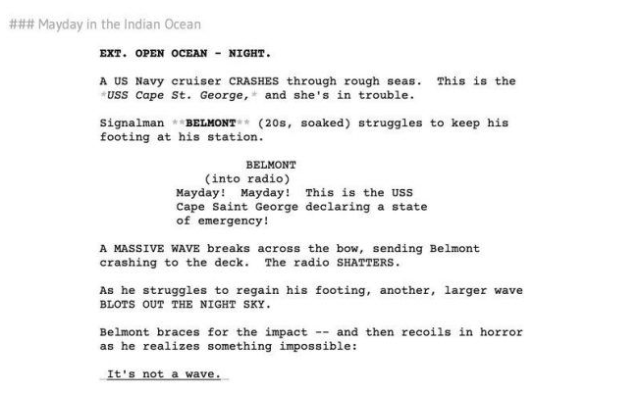
Slug Lines
Slug lines describe:
the location of a scene,
the time of the scene,
whether it takes place inside (interior setting) or outside (exterior setting).
Notes:
Each new scene needs slug lines - scene headings that describe the location of a scene, the time of the scene, and whether it takes place inside (interior setting) or outside (exterior setting).

Slide 63
Description
The description within a screenplay includes:
Where the action takes place
Elements of a scene, such as characters and objects.

Slide 64
Description
When writing a story, it is sometimes better to show the audience, then review information through dialogue.
The description should communicate images that disclose details the audience needs to see.

Slide 65
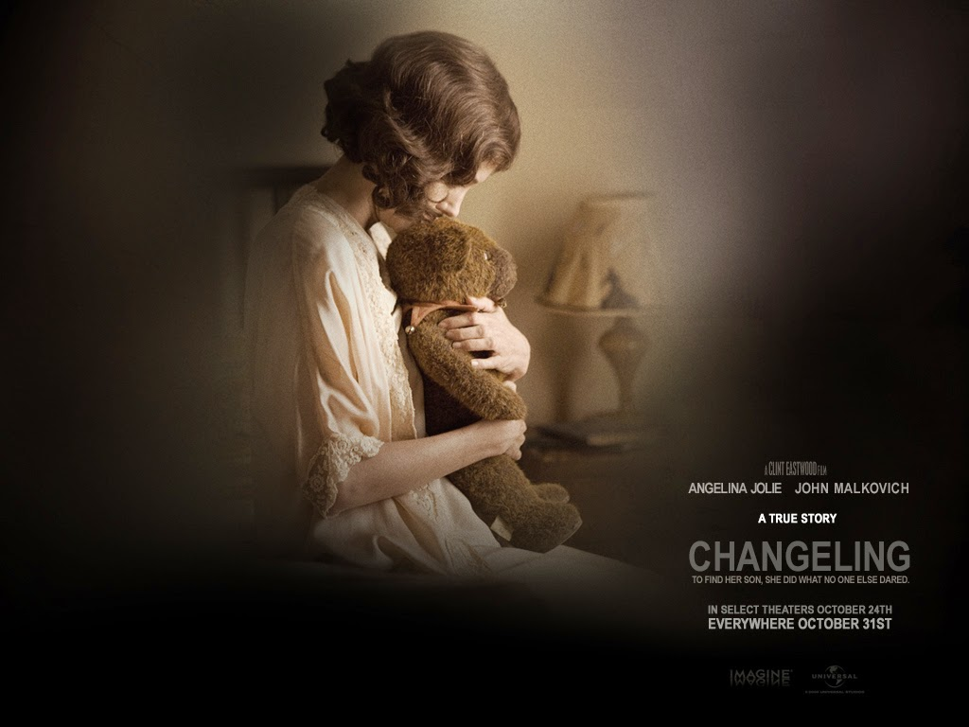
Description
Image of a mother absently touching frayed toys in a child's room is much richer than explaining verbally that the child no longer lives at home.
Notes:
For example, images of a mother absently touching frayed toys in a child's room is much richer than explaining verbally that the child no longer lives at home.

Slide 66
Description
In other words:
A picture is worth a thousand words
Leave enough in there to inform, but let the audience decide how they feel.
Notes:
For example, images of a mother absently touching frayed toys in a child's room is much richer than explaining verbally that the child no longer lives at home.

Slide 67
Dialogue
Show rather than say it. However, that does not mean that there is no reason for dialogue.
Use dialogue when you want to express a characters emotions, explore the interactions between characters and the environment, and to move the story forward.
Notes:
An important rule is to show rather than say it.
However, that does not mean that there is no reason for dialogue.
On the contrary. You should use dialogue when you want to express it characters emotions, explore the interactions between characters and the environment, and to move the story forward.

Slide 68
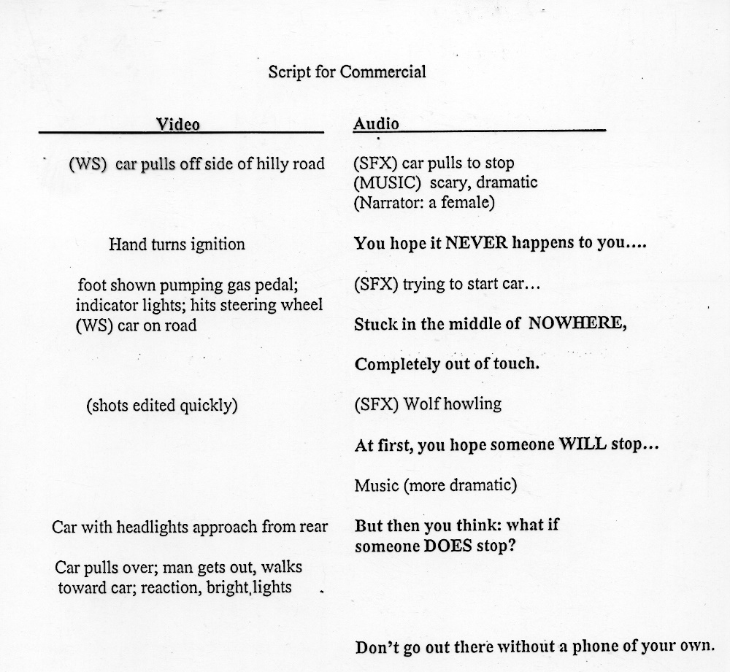
Two Column Script
Frequently used for corporate videos, documentaries, multimedia, and news.
Broken into two columns (video and audio)
Left contains video information, with audio on the right.
Notes:
The two-column script is frequently used for corporate videos, documentaries, multimedia, and news. The script is broken into two columns - for video and audio. The left column contains video information, with audio on the ride. Every Visual and audio element is specified in the appropriate column.

Slide 69
Two Column Script
Frequently used for corporate videos, documentaries, multimedia, and news.
Broken into two columns (video and audio)
Left contains video information, with audio on the right.
Notes:
For example, information about camera Framing and movement is usually described in the video column, and information about dialog and music in the audio column.
Many video and news people used to column script format because the visuals are easily synchronized to the audio.

Slide 70
Storyboards
Series of sketches that are used as a planning tool
Visually shows how the action of a story unfolds.
Facilitates production.
Main purpose – to clearly convey the narrative flow of a story by defining the challenges and problems of a project.
Understanding the elements is critical.
Notes:
Storyboards are a series of sketches that are used as a planning tool to visually show how the action of a story unfolds. The closest visual reflection to the storyboard is the comic strip minus the dialogue blooms. But we're as comic strips entertained, the storyboard is a tool that facilitates production.
The main purpose of the storyboard is to clearly convey The Narrative flow of a story by defining the challenges and problems of a project. Therefore, understanding the elements of the storytelling process is of utmost importance for the storyboard artist to do his or her job.

Slide 71
Who uses Storyboards?
Advertising Campaigns
Video Games
Animations
Feature Films
Television Series
Notes:
Advertising campaigns
Advertising agencies use presentation storyboards to sell campaign strategies to clients or for use in focus groups. Storyboards that reflect campaign ideas are highly detailed and include key frames only.
Video Games
Video games take a lot of pre-planning, including brainstorming the game Concepts and user interaction. Once the storylines are developed, the game designer creates the storyboards for each scene of the game, including the Cinematic, or full motion video sequences, that introduce a story and act as the users reward for excelling in gameplay.
Television series
Usually when working in television, the director will storyboard only complex sequences. Some television shows that you storyboards include CSI, The West Wing, ER, Babylon 5, and Witchblade.

